Slide 1
Search on the Web

Slide 2
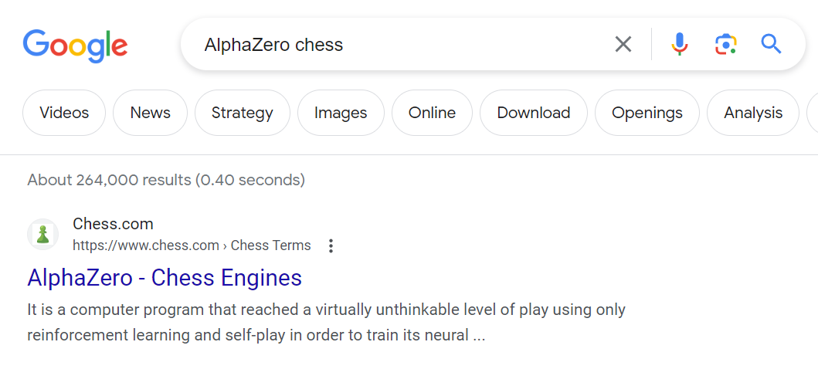
Search on the Web: Example
Suppose you ask Google about AlphaZero chess program:
How does Google answer your question?

Slide 3
General Approach
Relevance. The first task is to find web pages relevant to the query words. This task is performed using information-retrieval techniques and an index (created by a Web crawler).
Need of ranking. Typically, the number of pages relevant to the query is enormous, thousands or even millions. A typical user looks at only one or two screens. What should be the order in which these pages are displayed to the user?
Key problem: ranking. The pages must be ordered (ranked) so that more “useful” pages precede less “useful”.

Slide 4
Early Approaches to Ranking
The ranking in early web search engines (the mid of the 1990s) has poor quality. The ranking was essentially a combination of the following three measures:
Content. A measure based on the analysis of the content of a page.
Term frequency. A measure based on the number of occurrences of the query words on a page. Easy to spam.
Number of visits. A measure based on the number of visits of a page. Easy to spam.

Slide 5
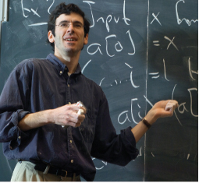
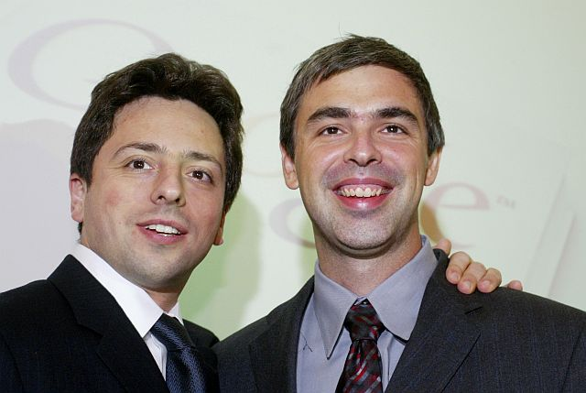
New Idea: Link Analysis
HITS (Jan 1998)
PageRank (Apr 1998)
Jon Kleinberg
Cornell University
Sergey Brin and Larry Page
Google’s co-founders
Both algorithms were based on the same idea: link analysis.

Slide 6
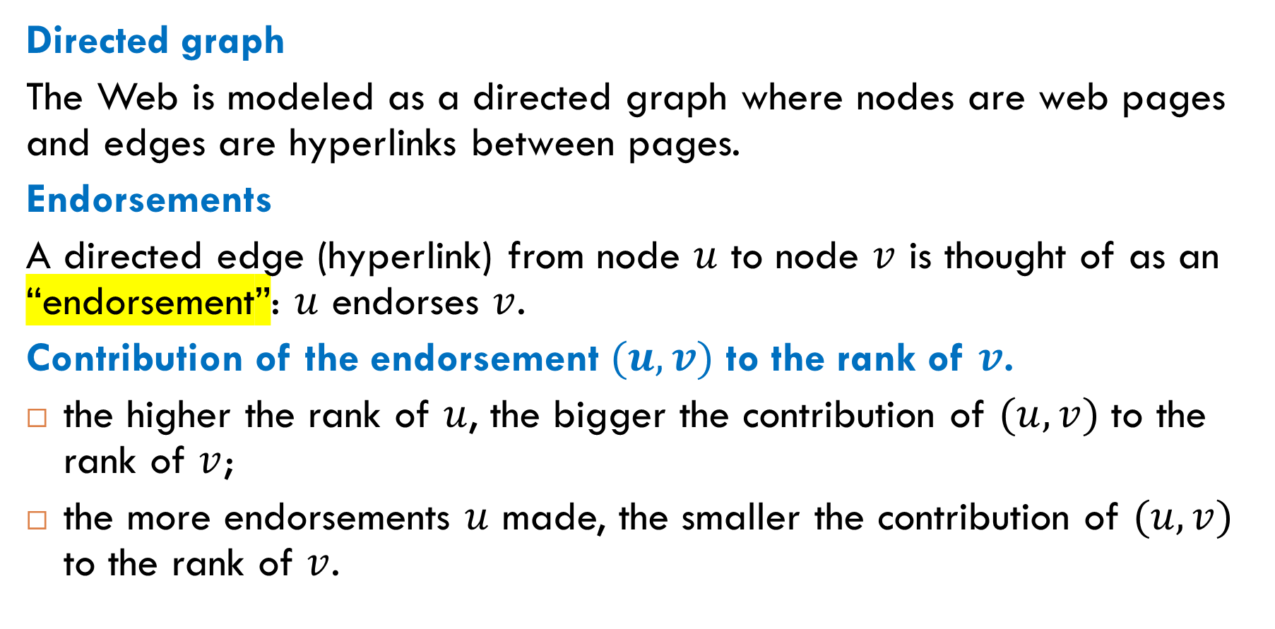
Link Analysis: Idea
Directed graph
The Web is modeled as a directed graph where nodes are web pages and edges are hyperlinks between pages.
Endorsements
A directed edge (hyperlink) from node $u$ to node $v$ is thought of as an “endorsement”: $u$ endorses $v$.
Contribution of the endorsement $(u, v)$ to the rank of $v$.
the higher the rank of $u$, the bigger the contribution of $(u, v)$ to the rank of $v$;
the more endorsements $u$ made, the smaller the contribution of $(u, v)$ to the rank of $v$.

Slide 7
The Web Graph

Slide 8
What Is the Web Graph?
The Web graph is a directed graph in which
the vertices are static web pages;
the directed edges are hyperlinks between static web pages.
A static web page is a web page that is delivered to the user exactly as stored, in contrast to dynamic web pages which are generated on the fly by a web application. For example, the RU web page is static, but a web page created by Google when you do a web search is dynamic.

Slide 9
Do We Know the Web Graph’s Structure?
Answer. No, we don’t know the Web graph’s structure.
Crawlers. The structure of the Web graph can be learned only using crawlers, computer programs that automatically surf the Web. In its simplest form, a crawler performs a breadth-first search.
Not all static pages. Crawlers cannot find all static pages on the Web. Here are two main reasons:
Many pages do not have incoming links. Or, more generally, many pages are not reachable from the page where the crawler starts.
Many websites do not allow crawlers to examine some of their pages.

Slide 10

How Big Is the Web?
Question: What is the current size of the Web graph? It is not easy to answer this question. Still, …
More precise question: How many web pages are indexed by a search engine?
Estimations of the current indexed Web
worldwidewebsize.com
Google: between $30$ and $50$ billion pages
Bing: between $8$ and $14$ billion pages

Slide 11
Problems with Web Size Estimation
Many different approaches to indexing web pages. None is perfect.
Depth of indexing. When indexing a web site, search engines may index only pages whose depth does not exceed some threshold. Different thresholds.
Duplicates and near duplicates. Around 40% of web pages are duplicates of other pages. Search engines try to avoid indexing multiple copies of the same content. Techniques for detecting duplicates and near duplicates:
fingerprinting;
Jaccard similarity coefficients.

Slide 12
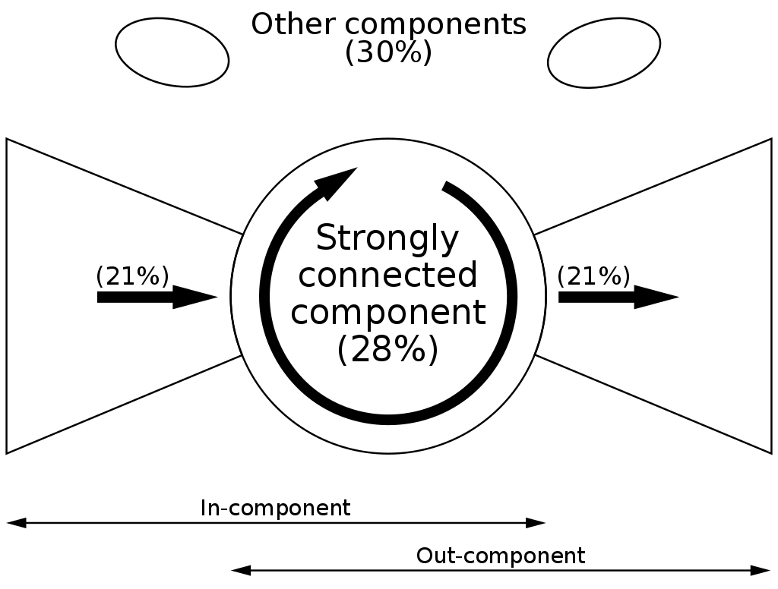
Structure of the Web Graph: Studies
The first overall picture was made in 2000 (Alta Vista, about 200 million pages and 15 billion hyperlinks.
Next studies showed that the aggregate picture (the “bow-tie” structure) remains relatively stable over time.

Slide 13
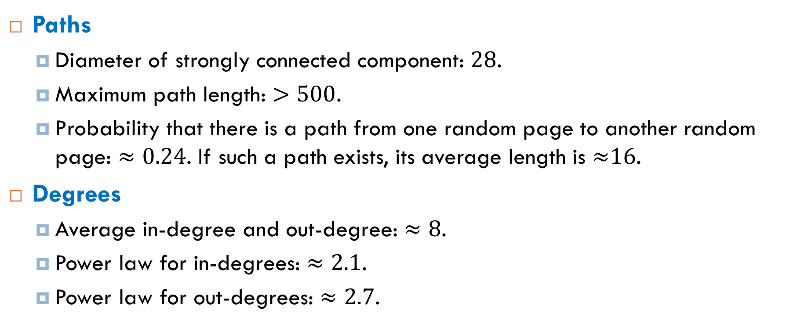
Basic Statistics (Table 10.2 in Newman’s Book)
Paths
Diameter of strongly connected component: $28$.
Maximum path length: $>500$.
Probability that there is a path from one random page to another random page: $≈0.24$. If such a path exists, its average length is ≈16.
Degrees
Average in-degree and out-degree: $≈8$.
Power law for in-degrees: $≈2.1$.
Power law for out-degrees: $≈2.7$.

Slide 14
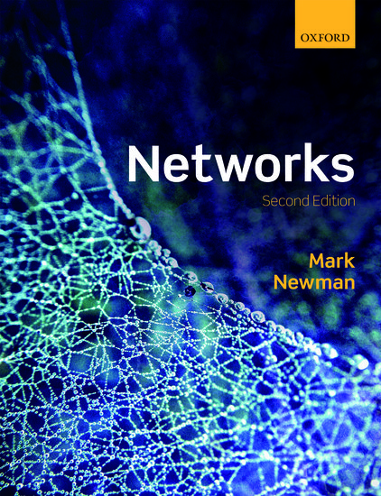
Reading
Section 10.1.1

